Slide 1
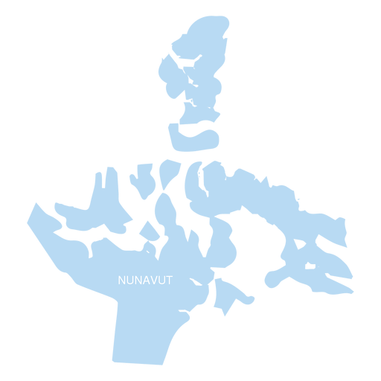


Nunavut: The Deadliest Territory Data Visualization Competition
Apery Kira, Jun Huang, Tijana Rajic, Valay Shah

Slide 2
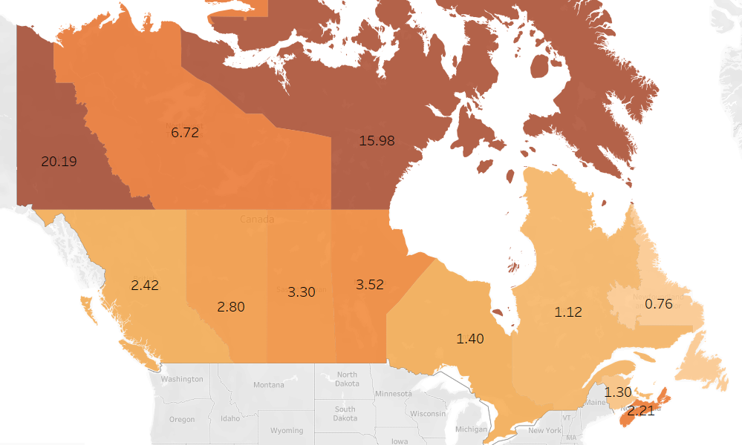
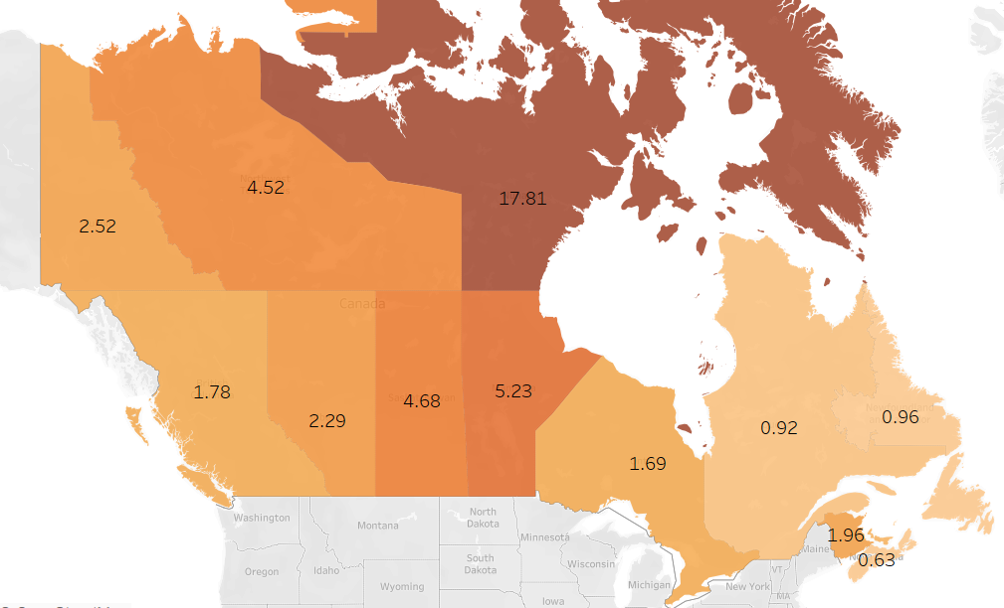

Nunavut
15.98
17.81
2017
2019
Notes:
Map – while homicide rates have decreased in other provinces and territories (e.g., Yukon went down from 20 to about 3), they did not really improve in Nunavut (e.g., went from around 16 in 2017 to 18 in 2019) deaths per 100,000 people
https://www150.statcan.gc.ca/n1/pub/85-002-x/2019001/article/00016-eng.htm

Slide 3
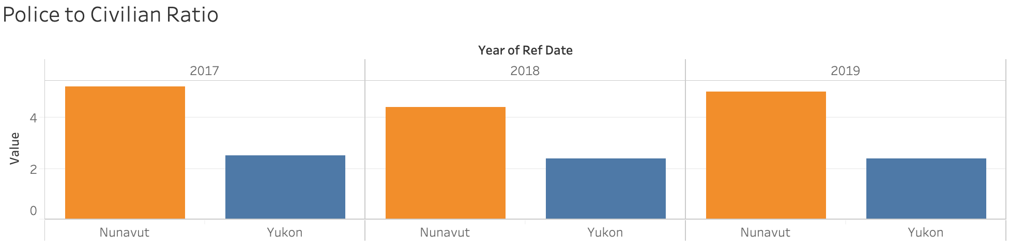
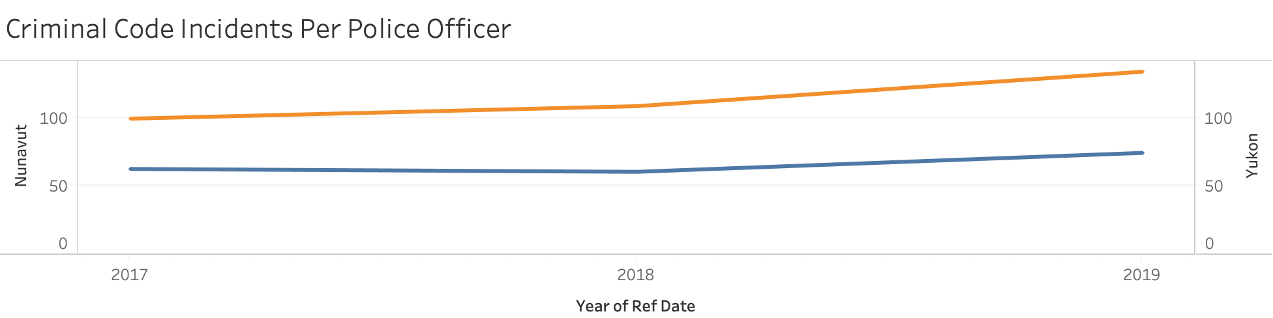
Nunavut vs. Yukon
Notes:
If we look at the police to civilian ratio, Nunavuts been pretty consistent and significantly higher than other territories, but if we look at their criminal code incidnets per police officer, it is still going up each year, that is quite alarming because in most instances, if you have more police officers, they are able to disperse the incidents so that they would be accounting for less crimes per police officer but that is not the case
Police officers are taking on more cases year after year even though they have a relatively high police to civilian ratio,
If we look at the first graph, we can see that
There should be enough policing services to accommodate criminal code incidents, evenly distributed across police force, however our bottom visual is indicating that that is not the case

Slide 4
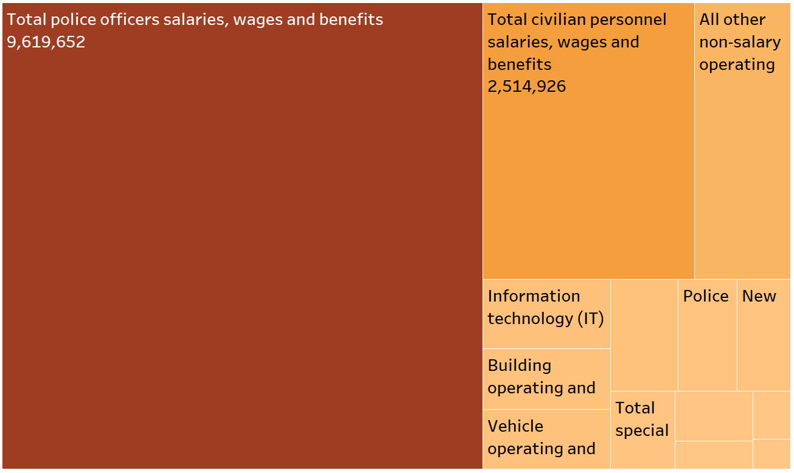
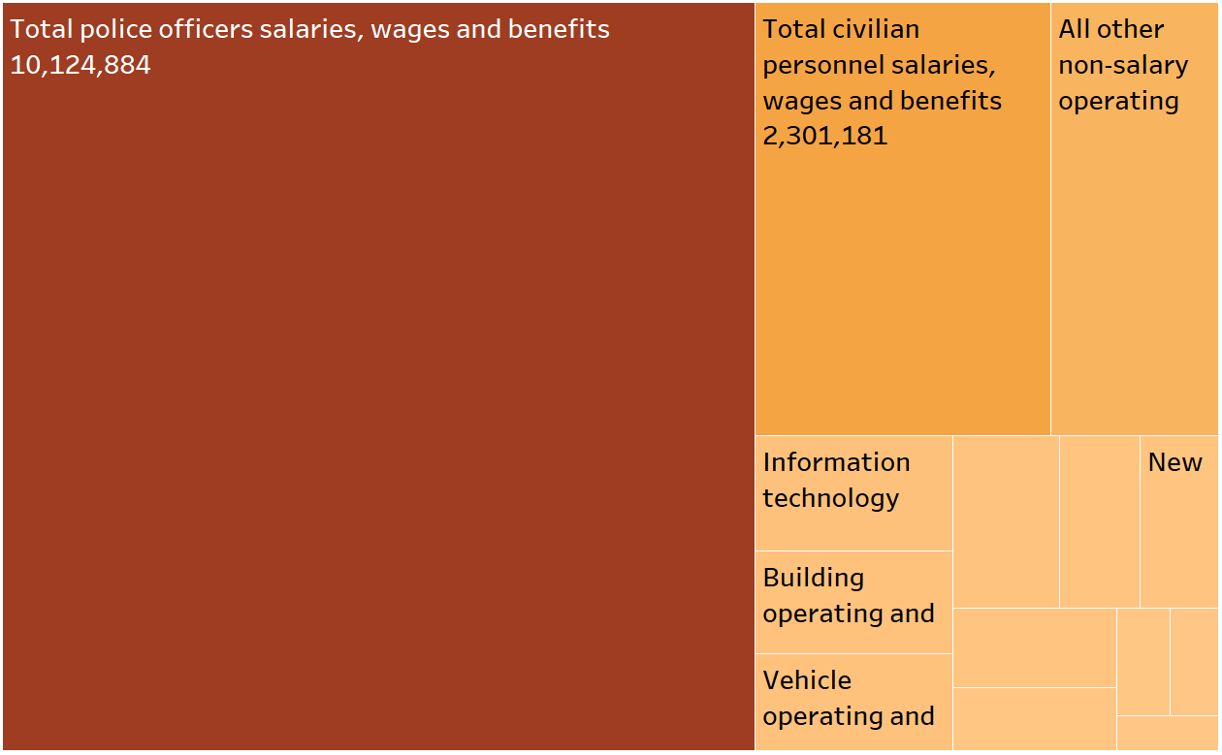
Police Resources Expenditure Breakdown
2018
2019
Professional services
Professional services
Training
Training
Notes:
We are spending a lot of money on police officers and benefits and wages but despite this, Nunavut still has a massive problem with homicides and crime rates as mentioned earlier
In 2018, we can see that the vast number of resources are going towards employing police officers while other areas such as contracts for professional services to help the community or total special constable expenditures are only a small proportion of the cost related to police officers

Slide 5
Indigenous Representation
Notes:
Not only is the rate of homicide for Indigenous people 5 times higher than non-indigenous people, the rate of Indigenous persons accused of homicide in 2018 was 8 times higher compared to non-Indigenous accused persons, given this, we can look at the rate of homicide victims by Aboriginal identity, it is evident that no matter your gender, an individuals Aboriginal identity poses then at a higher risk than non-aboriginals
This is concerning because the indigenous population accounts for more than 86% of the population in Nunavut (2016)
Highlight that these issues might be a result of the indigenous representation in Nunavut,
https://www150.statcan.gc.ca/n1/pub/85-002-x/2019001/article/00016-eng.htm
https://www150.statcan.gc.ca/n1/pub/85-002-x/2017001/article/54879-eng.htm
https://www12.statcan.gc.ca/census-recensement/2016/as-sa/fogs-spg/Facts-PR-Eng.cfm?TOPIC=9&LANG=Eng&GK=PR&GC=62

Slide 6
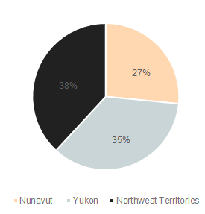
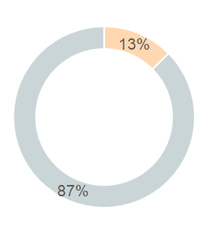

Mental Health
Health Services Budget in Territories
Mental Health Funding in Nunavut
2018
2018
Notes:
In 2018, the proportion of Indigenous victims killed by someone they knew (96%) was higher than non-Indigenous victims (75%) (Table 8)
In 2018, the proportion of Indigenous victims killed by someone they knew (96%) was higher than non-Indigenous victims (75%) (Table 8).
Number of spousal homicides increased by 9—6 male victims and 3 female victims—in 2018
According to police reported crime statistics, women account for about 8 in 10 victims of intimate partner violence. The same is true with respect to homicide. In 2018, 77% of homicide victims killed by a current or previous spouse or an intimate partner were female (Table 9)
In 2018, just under two-thirds (63%) of adults 18 years and older accused of homicide had a criminal record in Canada, whereas just over one-third (35%) of accused persons 12 to 17 years old had a youth record
Just over half (51%) of adult homicide victims had a Canadian criminal record.
Attributed to mental health? – mention this earlier on in the presentation?
Police suspected the presence of a mental or developmental disorderNote in 19%Note of persons accused of homicide in 2018. This proportion is slightly higher than the previous 10-year average (16%).Note Police suspected the presence of a mental disorder in female accused more frequently (23% of female accused)Note than when the accused was a male (19% of male accused).Note Half (51%) of the solved homicides committed by someone with suspected mental or developmental disorder were committed against family members. Moreover, homicides by someone with a suspected disorder were committed by persons aged 18 to 29 years (38%), followed by 30 to 39 years (26%). Accused persons suspected to have a mental or developmental disorder most often used a knife or other piercing or cutting instrument (42%) followed by a firearm (27%).
References:
Cathy Gulli with Patricia Treble October 14, 2. (2017, November 22). Canada's shame. Retrieved March 09, 2021, from https://www.macleans.ca/news/canada/canadas-shame

Slide 7
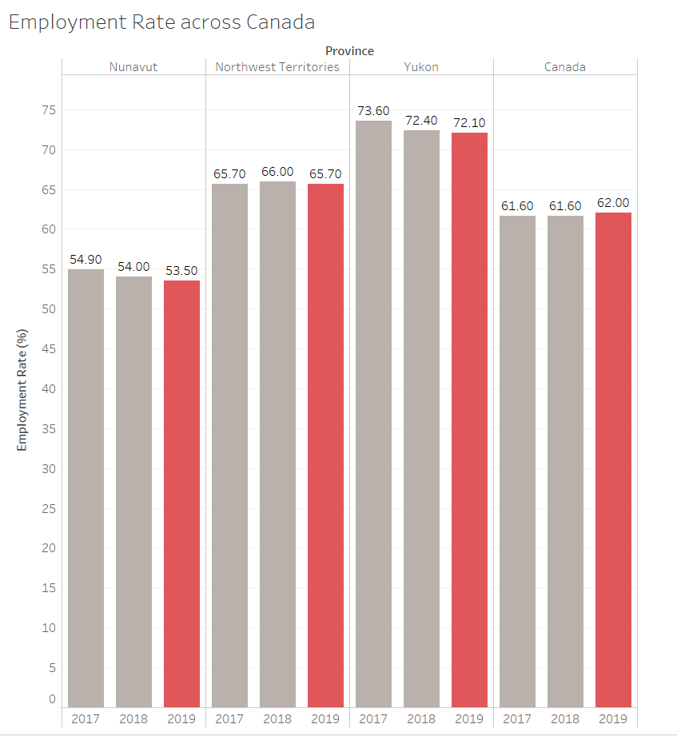
Employment Rate
Notes:
Leads to empty hands
High school graduation rate (47.8% in Nunavut vs 86.3% in Canada)
One of the limitations of resources in Nunavut is the lack of economic development in the territory
●Nunavut has the lowest employment rates across all territories at an employment rate of 53.5
●Reasons behind low employment rates include high cost of living and high recruiting costs for licensed professionals
In Nunavut Legal Services Study completed by the Department of Justice, recruitment costs were ranging close to $30,000 for a legal professional
***the pie chart doesn’t work with the percentages ): - jun

Slide 8
Our Findings
Highest Homicide Rates
High Police Presence
Nunavut has a homicide rate that is triple the national average.
Nunavut has the highest police-civilian ratio.
Indigenous Community
Mental Health
Nunavut has a relatively large indigenous community..
Nunavut suffers from lack of employment and mental health.
Notes:
Despite Nunavut having the highest police-to-civilian ratio, Nunavut still has the highest homicide rate.
Since most of Nunavut’s population is Indigenous people, this population is therefore disproportionately affected by the lack of employment and poor mental health, resulting in a vicious cycle of poverty.

Slide 9

Recommendations
Training
Holistic Support
MHFA & PDCIP
Multidisciplinary teams with traditional healers
IMPACT Program
Employment Aid
Pair police with mental health workers
WEP & entrepreneurship support
Notes:
Therefore, we recommend providing Nunavut’s police force with more Mental Health First Aid training and Indigenous community training. Since police are the first point of contact with the criminal system, this training will allow them to better respond to the legal, emotional and cultural aspects of the Indigenous community.
We also recommend a program where police are paired with mental health workers to help police better respond to mental health crises.
In addition to improving Nunavut’s policing efforts, we also recommend thinking of upstream factors. This includes multidisciplinary teams with Aboriginal social workers and traditional healers, who would provide holistic care to address the unique trauma and addiction struggles of this population. This would then prevent the exacerbation of these issues, thereby reducing crime rates.
Lastly, to address the lack of employment, we recommend providing Work Experience Programs, which would allow youth to learn about career options and earn an income to fund their education, as well as entrepreneurship programs that would provide Indigenous people with funding, networking, and training to help them become self-employed, recruit others, and support their local communities and businesses.
Training
MHFA - https://www.mhfa.ca/en/course-type/police (MHFA Police focuses on improving police interactions where mental health may be an issue. Participants build the knowledge, skills, and confidence to respond effectively to someone who may be experiencing a mental health issue or crisis.)
PDCIP - The Professional Development Centre for Indigenous Policing (PDCIP) provides advanced training to police officers working in Indigenous communities. These officers operate in rural and remote locations and often assume leadership roles. They need training to respond to the legal, emotional and cultural aspects of policing. The intensive and interactive training helps students develop working relationships with colleagues from Indigenous communities across Canada. Courses offered: Indigenous Gang Reduction Strategies (IGRS), Integrated Approaches to Interpersonal Violence and Abuse (IAIVA), Strategic Policing through Action and Character leadership development course (with an Indigenous lens) (SPAC)
Similar to Kitchener-Waterloo’s Integrated Mobile Police and Crisis Team (IMPACT) program, Nunavut can have a program that pairs police with mental health workers to help police better respond to mental health calls (https://www.cbc.ca/news/canada/kitchener-waterloo/impact-wrps-mental-health-police-waterloo-kitchener-1.5782205)
Calls to IMPACT come in from 911, and from police officers asking for support in the field. When an IMPACT staffer is sent to a mental health crisis, police officers first make sure the situation is safe for them.
The IMPACT staffer will then clinically assess a person's situation, de-escalate the crisis and decide on next steps. They will also follow up with the person after the fact to ensure they have ongoing mental health support.
"All of that requires clinical training and background, which the police don't have, that's not what their primary mandate is," said Fishburn.
As a result of the IMPACT partnership, they can often help people without having to hospitalize or arrest them unnecessarily.
Similar to CAMH’s holistic support, provide multidisciplinary teams with Aboriginal social workers, an elder/traditional healer, and psychiatrist who are able to then provide care tailored to the unique needs of Aboriginal populations (https://www.camh.ca/en/your-care/programs-and-services/aboriginal-substance-use-outpatient--counselling-service)
The Aboriginal Service blends therapeutic and psycho-educational groups with cultural programming and ceremonies as part of a holistic approach to care.
Employment Aid
Youth Work Experience Program - Projects under the First Nations and Inuit Summer Work Experience Program allow youth to learn about career options and earn an income that may contribute to a university or college education. (https://www.sac-isc.gc.ca/eng/1100100033610/1533125433575)
Indigenous People often confront barriers when seeking to become entrepreneurs— therefore this program would provide them with access to business financing, professional networks and financial literacy training to help them when considering the path of self-employment and supporting their local communities (https://www.oecd-ilibrary.org/sites/9789264300477-8-en/index.html?itemId=/content/component/9789264300477-8-en)

Slide 10
Thank you!

Slide 11
Appendix
Incarceration Rates
Crime incidents
Crime severity
Police expenditure breakdown (2019)
Sources

Slide 12
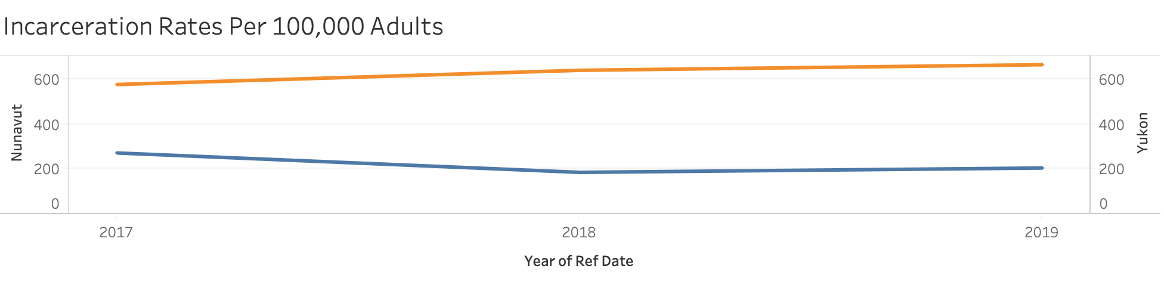
Nunavut vs. Yukon
Notes:
USE AS REFERENCE
In addition to high homicide rates, Nunavut has one of the highest crime severity indexes, which is a measure of the seriousness of the crime, in comparison to Yukon which has a similar population size to Nunavut, it has a significantly lower crime severity index
Yukon has a closer population size compared to Nunavut

Slide 13
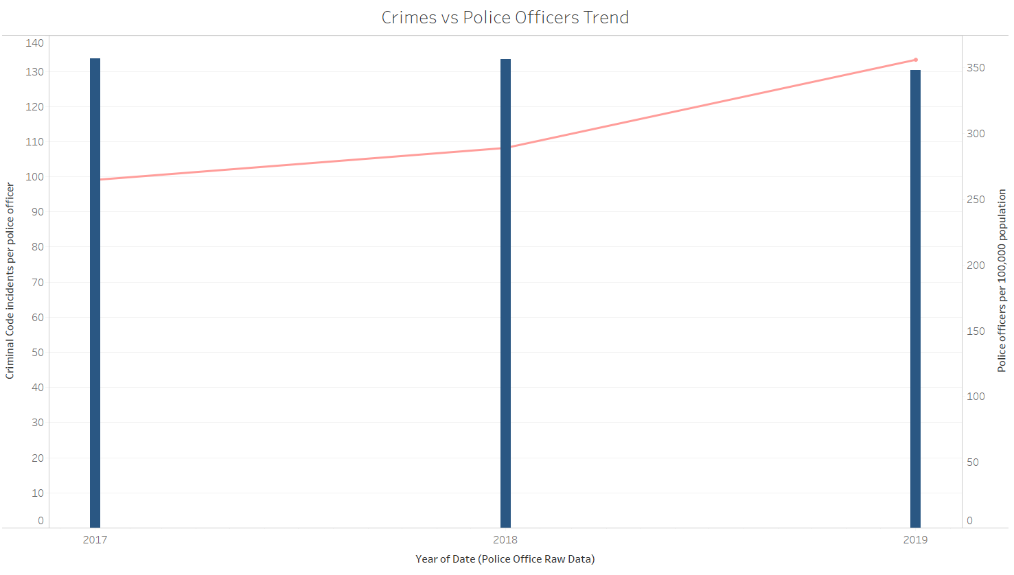


Crime Incidents vs. # of Police Officers
Notes:
Crime incidents per police officer are increasing as well while police officers per 100,000 civilians are remaining around the same level,
This graph further shows that the problem in Nunavut regarding crime cannot merely be solved by more police officers

Slide 14
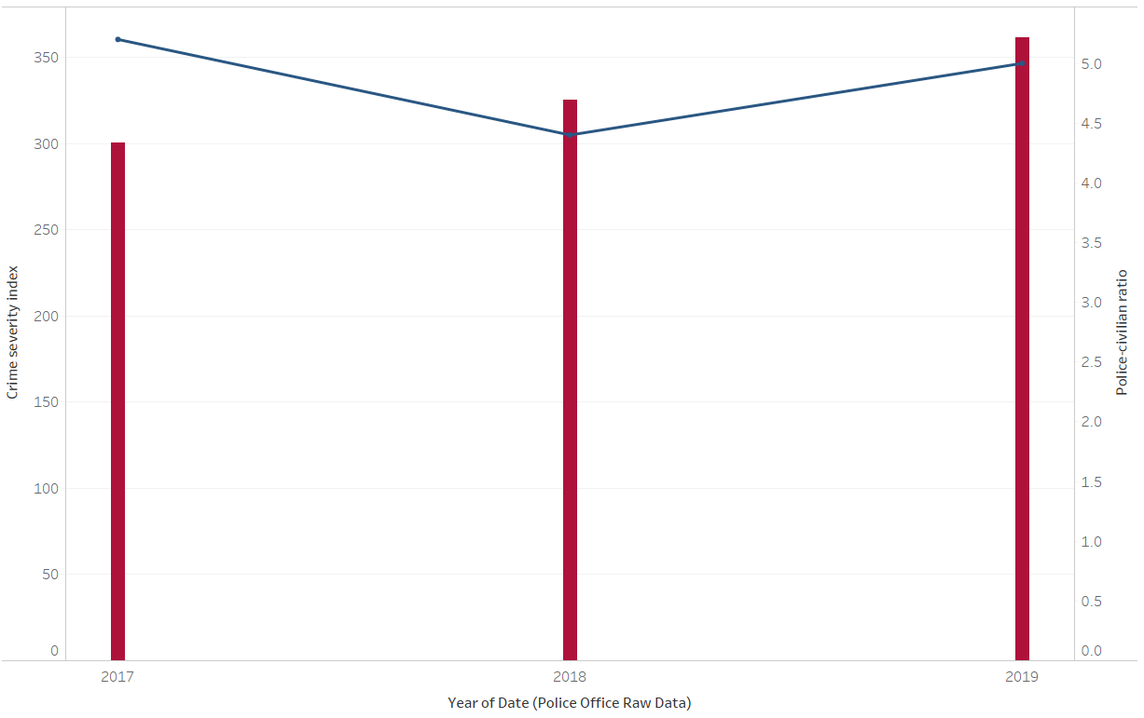

Crime Severity and Police Civilian Ratio
Notes:
In addition to what Jun mentioned,
Crimes have continued to increase from 2017 to 2019 despite the police to civilian ratio (police per 1000 citizens) staying about the same
Crimes are also getting worse in terms of severity despite a higher number of police officers
This seems to indicate that simply having more police officers per capita is not conducive to improving the situation in Nunavut; a different strategy is in need

Slide 15
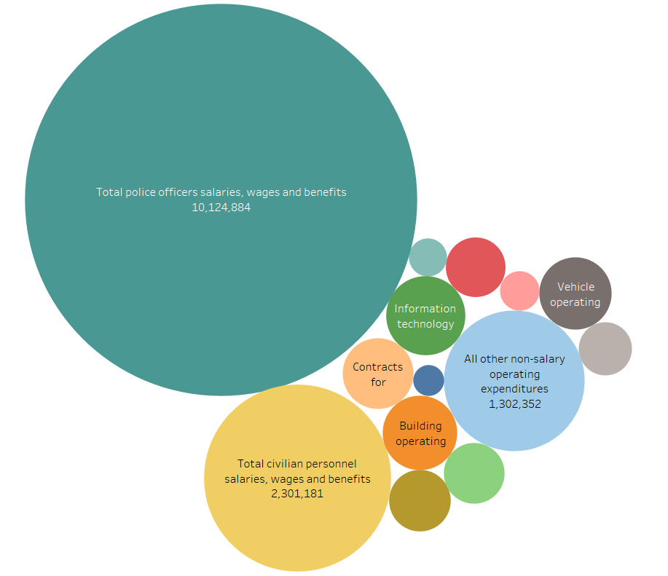
Police Resources Expenditure Breakdown (2019)
Notes:
In 2019, we can see a similar story, with police officer employment expenditures increasing from 2018 to 2019 and it taking up a massive proportion of police resources and it dwarfs all other methods of community service help

Slide 16
Sources (APA)
Cathy Gulli with Patricia Treble October 14, 2. (2017, November 22). Canada's shame. Retrieved March 09, 2021, from https://www.macleans.ca/news/canada/canadas-shame/
Roy, J., & Marcellus, S. (2019, November 27). Homicide in Canada, 2018. Retrieved from https://www150.statcan.gc.ca/n1/pub/85-002-x/2019001/article/00016-eng.htm
Government of Canada. (2019 April 10). Focus on Geography Series, 2016 Census. Retrieved from https://www12.statcan.gc.ca/census-recensement/2016/as-sa/fogs-spg/Facts-PR-Eng.cfm?TOPIC=9&LANG=Eng&GK=PR&GC=62
Statistics Canada. (2019). Table: 35-10-0076-01. Police personnel and selected crime statistics. [Data table]. https://www150.statcan.gc.ca/t1/tbl1/en/tv.action?pid=3510007601&pickMembers%5B0%5D=1.15&cubeTimeFrame.startYear=2015&cubeTimeFrame.endYear=2019&referencePeriods=20150101%2C20190101
Statistics Canada. (2020). Table: 35-10-0154-01. Average counts of adult in provincial and territorial correctional programs. [Data table]. https://www150.statcan.gc.ca/t1/tbl1/en/tv.action?pid=3510015401&pickMembers%5B0%5D=1.7&cubeTimeFrame.startYear=2014+%2F+2015&cubeTimeFrame.endYear=2018+%2F+2019&referencePeriods=20140101%2C20180101
Notes:
https://www.macleans.ca/news/canada/canadas-shame/
There's a cycle of abuse in households due to lack of employmenet and educational opportunities which laeds to idle hands --> only 5 communities in Nunavut with employment opps which leads to students not being motivated to go through highschool and results in a 75% dropout rate
The victims in households often have nowhere to go and experience severe trauma such as sexual and physical abuse, the frequency of suicide, addiction to drugs and alcohol, which all gets exacerbated by the lack of social services
This leads to Nunavut having the highest CSI (homicides + sexual assaults) in the country
Alcohol in communities also leads to fetal alcohol syndrome and can cause behavioural problems for children in school
To exacerbate this issue, there are too few crisis centres and second-stage housing for women and families trying to get their feet under them after fleeing domestic abuse, often women have no other option than to go back to the houses where the men are violating them
The justice system is really the end of the line. It’s all this other stuff: education, health, housing, that has to be improved. With that improved over the long term we might see real change and there might be less crime. But it’s going to take a long time and a lot of work

